Slide 1
Single Entity MSBA BAN 6020 Data Management
Carolina Salge

Slide 2
Modeling Reality
A database must mirror the real world if it is to answer questions about the real world
Data modeling is a design technique for capturing reality
A relational database is a collection of relations, where relation is a mathematical term for a table

Slide 3

Entity
Something in the environment
Physical (student)
Conceptual (work assignment)
Represented by a rectangle

Slide 4
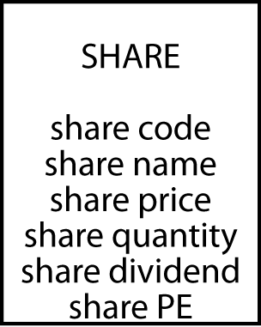
Attribute
Discrete data element describing an entity
Names of attributes must be unique and meaningful

Slide 5
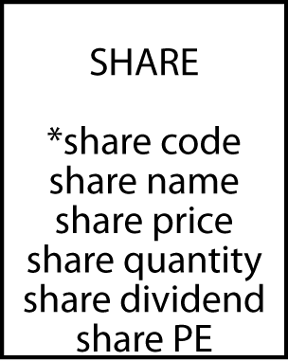
Identifier
Every instance of an entity must be uniquely identified
An identifier can be one or many attributes and is recognized by an asterisk

Slide 6
Exercise
Design a data model for Olympic cities
http://en.wikipedia.org/wiki/List_of_Olympic_Games_host_cities

Slide 7
Rules
Each entity becomes a table
The entity name becomes the table name
Each attribute becomes a column
The identifier becomes the primary key

Slide 8
Define a Table
create table share (
shrcode char(3),
shrfirm varchar(20) not null,
shrprice decimal(6,2),
shrqty decimal(8),
shrdiv decimal(5,2),
shrpe decimal(2),
primary key(shrcode));

Slide 9
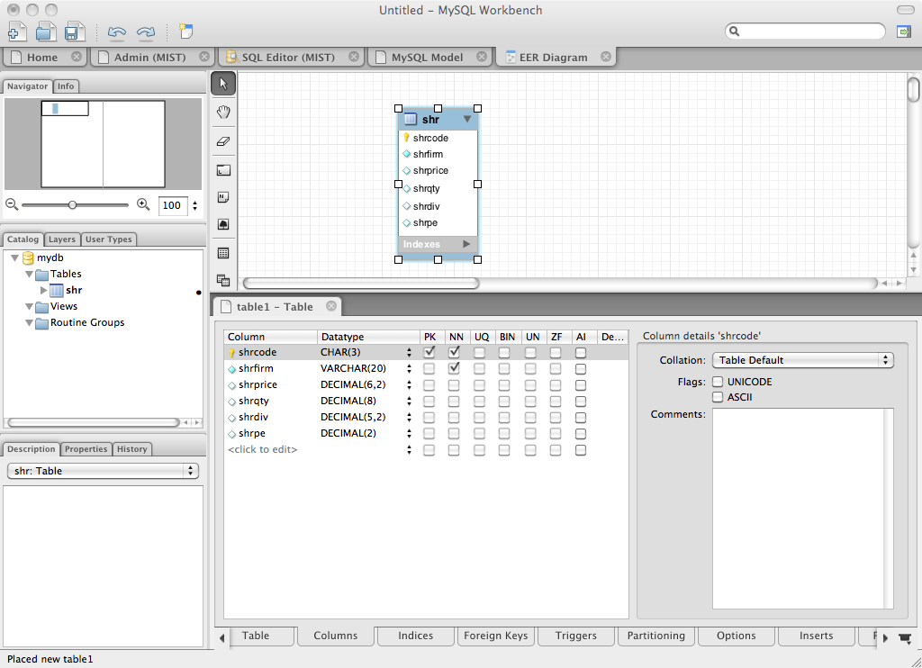
Table in MySQL Workbench

Slide 10
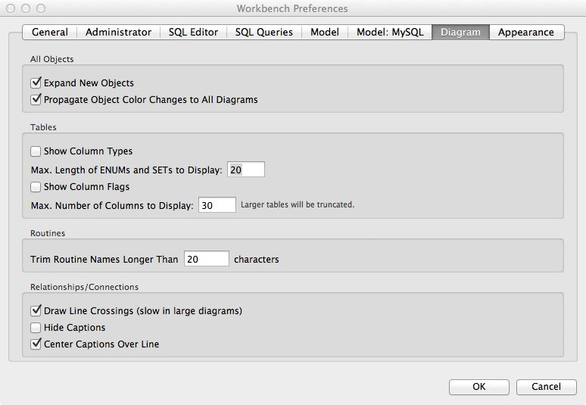
MySQL Workbench Preferences
Hide column type
Hide column flag

Slide 11
Data Types
SQL standard
Numeric | integer | A 31-bit signed binary value
 | smallint | A 15-bit signed binary value
 | float(p) | A scientific format number of p binary digits precision
 | decimal(p,q) | A packed decimal number of p digits total length; q decimal places to the right of the decimal point may be specified
String | char(n) | A fixed length character string of n characters
 | varchar(n) | A variable length character string up to n characters
 | text | A variable-length character string of up to 65,535 characters
Date/time | date | Date in the form yyyymmdd
 | time | Time in the form hhmmss
 | timestamp | A combination of date and time to the nearest microsecond
 | time with time zone | Same as time, with the addition of an offset from UTC of the specified time
 | timestamp with time zone | Same as timestamp, with the addition of an offset from UTC of the specified time

Slide 12
The Share Table
share
shrcode | shrfirm | shrprice | shrqty | shrdiv | shrpe
FC | Freedonia Copper | 27.50 | 10529 | 1.84 | 16
PT | Patagonian Tea | 55.25 | 12635 | 2.50 | 10
AR | Abyssinian Ruby | 31.82 | 22010 | 1.32 | 13
SLG | Sri Lankan Gold | 50.37 | 32868 | 2.68 | 16
ILZ | Indian Lead & Zinc | 37.75 | 6390 | 3.00 | 12
BE | Burmese Elephant | 0.07 | 154713 | 0.01 | 3
BS | Bolivian Sheep | 12.75 | 231678 | 1.78 | 11
NG | Nigerian Geese | 35.00 | 12323 | 1.68 | 10
CS | Canadian Sugar | 52.78 | 4716 | 2.50 | 15
ROF | Royal Ostrich Farms | 33.75 | 1234923 | 3.00 | 6

Slide 13
Insert Rows
insert into share
(shrcode, shrfirm, shrprice, shrqty, shrdiv, shrpe)
values ('FC','Freedonia Copper',27.5,10529,1.84,16);
insert into share
values ('FC','Freedonia Copper',27.5,10529,1.84,16);

Slide 14
Import Data
load data local infile
'/Users/rtw/desktop/share.txt' into table share
fields terminated by ','
enclosed by "'"
lines terminated by '\r'
FC,'Freedonia Copper',27.5,10529,1.84,16
PT,'Patagonian Tea',55.25,12635,2.5,10
AR,'Abyssinian Ruby',31.82,22010,1.32,13
SLG,'Sri Lankan Gold',50.37,32868,2.68,16
ILZ,'Indian Lead & Zinc',37.75,6390,3,12
BE,'Burmese Elephant',0.07,154713,0.01,3
BS,'Bolivian Sheep',12.75,231678,1.78,11
NG,'Nigerian Geese',35,12323,1.68,10
CS,'Canadian Sugar',52.78,4716,2.5,15
ROF,'Royal Ostrich Farms',33.75,1234923,3,6

Slide 15
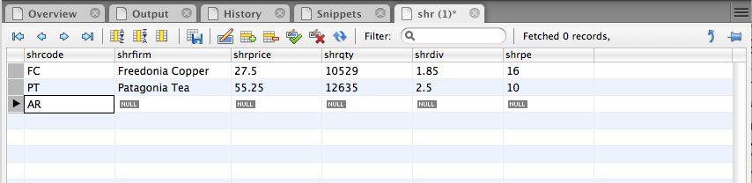
MySQL Workbench

Slide 16
Exercise
Use MySQL Workbench to design your data model for recording details of Olympic cities
Create a table and add rows for the first three Olympics

Slide 17
Querying a Table
List all data in the share table
select * from share;
shrcode | shrfirm | shrprice | shrqty | shrdiv | shrpe
FC | Freedonia Copper | 27.50 | 10529 | 1.84 | 16
PT | Patagonian Tea | 55.25 | 12635 | 2.50 | 10
AR | Abyssinian Ruby | 31.82 | 22010 | 1.32 | 13
SLG | Sri Lankan Gold | 50.37 | 32868 | 2.68 | 16
ILZ | Indian Lead & Zinc | 37.75 | 6390 | 3.00 | 12
BE | Burmese Elephant | 0.07 | 154713 | 0.01 | 3
BS | Bolivian Sheep | 12.75 | 231678 | 1.78 | 11
NG | Nigerian Geese | 35.00 | 12323 | 1.68 | 10
CS | Canadian Sugar | 52.78 | 4716 | 2.50 | 15
ROF | Royal Ostrich Farms | 33.75 | 1234923 | 3.00 | 6

Slide 18
Project
Choosing columns
A vertical slice
share
shrcode | shrfirm | shrprice | shrqty | shrdiv | shrpe
FC | Freedonia Copper | 27.50 | 10529 | 1.84 | 16
PT | Patagonian Tea | 55.25 | 12635 | 2.50 | 10
AR | Abyssinian Ruby | 31.82 | 22010 | 1.32 | 13
SLG | Sri Lankan Gold | 50.37 | 32868 | 2.68 | 16
ILZ | Indian Lead & Zinc | 37.75 | 6390 | 3.00 | 12
BE | Burmese Elephant | 0.07 | 154713 | 0.01 | 3
BS | Bolivian Sheep | 12.75 | 231678 | 1.78 | 11
NG | Nigerian Geese | 35.00 | 12323 | 1.68 | 10
CS | Canadian Sugar | 52.78 | 4716 | 2.50 | 15
ROF | Royal Ostrich Farms | 33.75 | 1234923 | 3.00 | 6

Slide 19
Project
Report a firm’s name and PE ratio
select shrfirm, shrpe from share;
shrfirm | shrpe
Freedonia Copper | 16
Patagonian Tea | 10
Abyssinian Ruby | 13
Sri Lankan Gold | 16
Indian Lead & Zinc | 12
Burmese Elephant | 3
Bolivian Sheep | 11
Nigerian Geese | 10
Canadian Sugar | 15
Royal Ostrich Farms | 6

Slide 20
Restrict
Choosing rows
A horizontal slice
share
shrcode | shrfirm | shrprice | shrqty | shrdiv | shrpe
FC | Freedonia Copper | 27.50 | 10529 | 1.84 | 16
PT | Patagonian Tea | 55.25 | 12635 | 2.50 | 10
AR | Abyssinian Ruby | 31.82 | 22010 | 1.32 | 13
SLG | Sri Lankan Gold | 50.37 | 32868 | 2.68 | 16
ILZ | Indian Lead & Zinc | 37.75 | 6390 | 3.00 | 12
BE | Burmese Elephant | 0.07 | 154713 | 0.01 | 3
BS | Bolivian Sheep | 12.75 | 231678 | 1.78 | 11
NG | Nigerian Geese | 35.00 | 12323 | 1.68 | 10
CS | Canadian Sugar | 52.78 | 4716 | 2.50 | 15
ROF | Royal Ostrich Farms | 33.75 | 1234923 | 3.00 | 6

Slide 21
Restrict
Report all firms with a PE less than 12
select * from share where shrpe < 12;
shrcode | shrfirm | shrprice | shrqty | shrdiv | shrpe
PT | Patagonian Tea | 55.25 | 12635 | 2.50 | 10
BE | Burmese Elephant | 0.07 | 154713 | 0.01 | 3
BS | Bolivian Sheep | 12.75 | 231678 | 1.78 | 11
NG | Nigerian Geese | 35.00 | 12323 | 1.68 | 10
ROF | Royal Ostrich Farms | 33.75 | 1234923 | 3.00 | 6

Slide 22
Project and Restrict
List the firm’s name, price, quantity, and dividend where share holding is at least 100,000
select shrfirm, shrprice, shrqty, shrdiv
from share where shrqty >= 100000
shrfirm | shrprice | shrqty | shrdiv
Burmese Elephant | 0.07 | 154713 | 0.01
Bolivian Sheep | 12.75 | 231678 | 1.78
Royal Ostrich Farms | 33.75 | 1234923 | 3.00

Slide 23
Exercise
Report the name and price of those shares where the share price is greater than 10

Slide 24
Note to Carolina
Stop here! Finish chapter 3 next class

Slide 25
Primary Key Retrieval
A PK query returns at most one row
Report firms who code is AR
select * from share where shrcode = 'AR';
shrcode | shrfirm | shrprice | shrqty | shrdiv | shrpe
AR | Abyssinian Ruby | 31.82 | 22010 | 1.32 | 13

Slide 26
Primary Key Retrieval
A non-PK query can return many rows
Report firms with a dividend of 2.5
select * from share where shrdiv = 2.5;
shrcode | shrfirm | shrprice | shrqty | shrdiv | shrpe
PT | Patagonian Tea | 55.25 | 12635 | 2.50 | 10
CS | Canadian Sugar | 52.78 | 4716 | 2.50 | 15

Slide 27
In
Used with a list of values
Report firms with FC, AR, or SLG codes
select * from share where shrcode in ('FC','AR','SLG');
select * from share where shrcode = 'FC' or
shrcode = 'AR' or shrcode = 'SLG';
shrcode | shrfirm | shrprice | shrqty | shrdiv | shrpe
FC | Freedonia Copper | 27.50 | 10529 | 1.84 | 16
AR | Abyssinian Ruby | 31.82 | 22010 | 1.32 | 13
SLG | Sri Lankan Gold | 50.37 | 32868 | 2.68 | 16

Slide 28
Not In
Not in a list of values
Report firms other than CS and PT
select * from share where shrcode not in ('CS', 'PT');
select * from share where shrcode <> 'CS' and
shrcode <> 'PT';
shrcode | shrfirm | shrprice | shrqty | shrdiv | shrpe
AR | Abyssinian Ruby | 31.82 | 22010 | 1.32 | 13
SLG | Sri Lankan Gold | 50.37 | 32868 | 2.68 | 16
ILZ | Indian Lead & Zinc | 37.75 | 6390 | 3.00 | 12
BE | Burmese Elephant | 0.07 | 154713 | 0.01 | 3
BS | Bolivian Sheep | 12.75 | 231678 | 1.78 | 11
NG | Nigerian Geese | 35.00 | 12323 | 1.68 | 10
ROF | Royal Ostrich Farms | 33.75 | 1234923 | 3.00 | 6

Slide 29
Order Columns
Columns
Reported in the order specified in the query
# left table
select shrcode, shrfirm from share where shrpe = 10;
#right table
select shrfirm, shrcode from share where shrcode = 10;
shrcode | shrfirm
PT | Patagonian Tea
NG | Nigerian Geese
shrfirm | shrcode
Patagonian Tea | PT
Nigerian Geese | NG

Slide 30
Order Rows
Rows
Use the order by clause
List firms with a PE of at least 12. Show results in descending order. For identical PE values, list firms in alphabetical order
select * from share where shrpe >= 12
order by shrpe desc, shrfirm;
shrcode | shrfirm | shrprice | shrqty | shrdiv | shrpe
FC | Freedonia Copper | 27.50 | 10529 | 1.84 | 16
SLG | Sri Lankan Gold | 50.37 | 32868 | 2.68 | 16
CS | Canadian Sugar | 52.78 | 4716 | 2.50 | 15
AR | Abyssinian Ruby | 31.82 | 22010 | 1.32 | 13
ILZ | Indian Lead & Zinc | 37.75 | 6390 | 3.00 | 12

Slide 31
Calculation
Get firm name, price, quantity, and firm yield
select shrfirm, shrprice, shrqty,
shrdiv/shrprice*100 as yield from share;
shrfirm | shrprice | shrqty | yield
Freedonia Copper | 27.50 | 10,529 | 6.69
Patagonian Tea | 55.25 | 12,635 | 4.52
Abyssinian Ruby | 31.82 | 22,010 | 4.15
Sri Lankan Gold | 50.37 | 32,868 | 5.32
Indian Lead & Zinc | 37.75 | 6,390 | 7.95
Burmese Elephant | 0.07 | 154,713 | 14.29
Bolivian Sheep | 12.75 | 231,678 | 13.96
Nigerian Geese | 35.00 | 12,323 | 4.80
Canadian Sugar | 52.78 | 4,716 | 4.74
Royal Ostrich Farms | 33.75 | 1,234,923 | 8.89

Slide 32
Exercise
Calculate the revenue earned by each share. Report the name of the firm and the revenue sorted from highest to lowest

Slide 33
Built-In Functions
count, avg, sum, min, and max
Find the average dividend
What is the average yield for the portfolio?
select avg(shrdiv) as avgdiv from share;
avgdiv
2.03
select avg(shrdiv/shrprice*100) as avgyield from share;
avgyield
7.53

Slide 34
Subqueries
A query within a query
Report all firms with a PE ratio greater than the average for the portfolio
select shrfirm, shrpe from share where shrpe >
(select avg(shrpe) from share);
shrfirm | shrpe
Freedonia Copper | 16
Abyssinian Ruby | 13
Sri Lankan Gold | 16
Indian Lead & Zinc | 12
Canadian Sugar | 15

Slide 35
Regular Expression
Search for alternative strings
[a|b] finds 'a' or 'b'
| is the alternation symbol
List the firms with gold or zinc in their name
select * from share
where shrfirm regexp 'gold|zinc|Gold|Zinc';

Slide 36
Regular Expression
Search for a beginning string
^ means at the start of the string
List the firms whose name begins with Sri
select * from share where shrfirm regexp '^Sri';

Slide 37
Regular Expression
Search for a ending string
$ means at the end of the string
List the firms whose name ends in Geese
select shrfirm from share where shrfirm regexp 'Geese$';

Slide 38
Exercises
Report names of shares whose name contains sheep or geese
List all firms containing ‘Ruby’ in their name

Slide 39
Distinct
Eliminate duplicate rows
Find the number of different PE ratios
select count(distinct shrpe) as 'different PEs’
from share; # left table
select distinct shrpe from share; # right table
different PEs
8
shrpe
3
6
10
11
12
13
15
16
DISTINCT column-name is not implemented by all relational systems

Slide 40
Delete
Erase the Burmese Elephant data since all shares were sold
delete from share where shrfirm = 'Burmese Elephant';

Slide 41
Update
Change the share price of FC to 31.50
Increase the total number of Nigerian Geese shares by 10% because of the bonus issue
update share set shrprice = 31.50
where shrcode = 'FC';
update share set shrqty = shrqty*1.1
where shrfirm = 'Nigerian Geese';

Slide 42
Quotes
Three kinds of quotes
Single ' (must be straight not curly)
Double " (must be straight not curly)
Back ` ( left of 1 key)
In MySQL, the first two are equivalent
select `person first` from person
where `person last` = "O'Hara";

Slide 43
Recap
Introduced
Entity
Attribute
Identifier
SQL
create
insert
select
delete
update

Slide 44
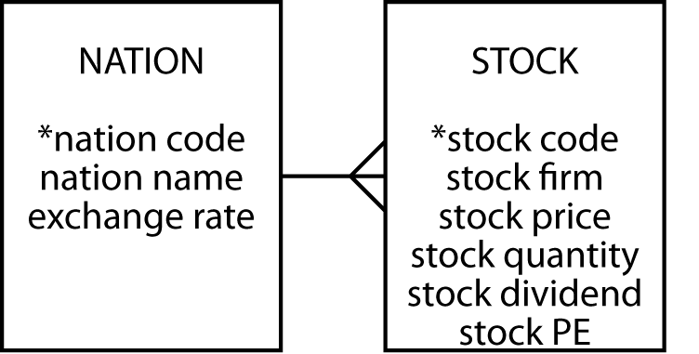
Next Class
One-To-Many Relationship (4)

